Slide 1
Event Framework CloudEvents for .NET
Introduction to Event Framework and to CloudEvents for .NET

Slide 2
Thousands of systems and applications use events and messaging for integration.
Almost all use propriety event formats.
No consistency, No portability, No accessibility.
Event Framework brings standard-based CloudEvents to .NET applications

Slide 3
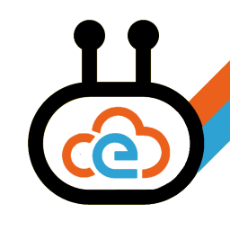



CloudEvents
Specification for describing event data in a common way.
Part of the Cloud Native Computing Foundation.
Integration, eventing and automation platform
Open source, open standards for .NET applications
Event Framework
CloudEvents for .NET
Part of the Weik.io Platform

Slide 4
CloudEvents

Slide 5
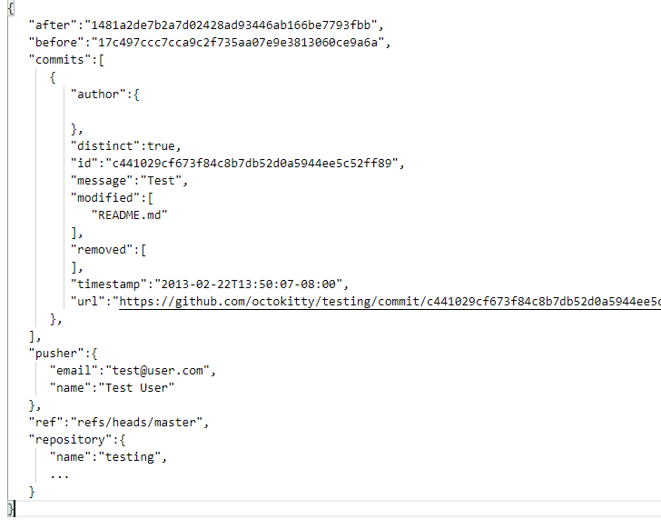
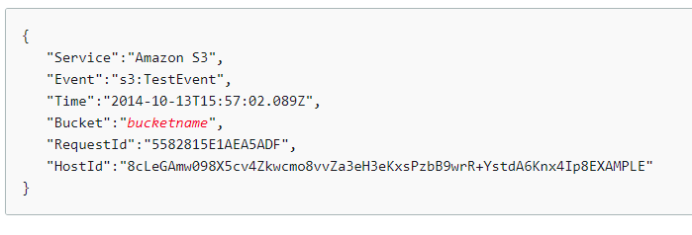
Why are CloudEvents needed?
Many applications use Webhooks for system to system integration

Slide 6
What is the problem with Webhooks?
It’s just JSON
All the systems have different structures
No consistency
No portability

Slide 7
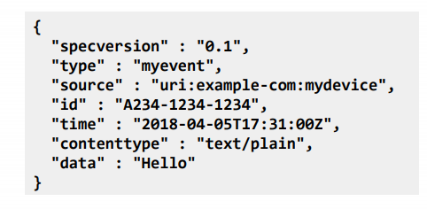
CloudEvents
CloudEvents is a specification for describing event data in common formats to provide interoperability across services, platforms and systems.
In short: It’s all about the metadata

Slide 8
CloudEvents continue
The specification is under the Cloud Native Computing Foundation.
https://cloudevents.io/

Slide 9
Event Framework

Slide 10
What is Event Framework?
Framework for creating, receiving, sending and handling CloudEvents in .NET.
Available for .NET Core 3.1.
Some parts available for .NET Standard 2.0.
The sweet spot is an ASP.NET Core 3.1 based application.
Open Source
Part of the Weik.io platform. Weik.io provides open source integration, eventing and automation frameworks for .NET applications.
Event Framework is the "eventing" part of the Weik.io platform.

Slide 11
Four Core Features
Create CloudEvents from .NET objects
Send and receive CloudEvents
Handle CloudEvents
Monitor and automatically publish CloudEvents

Slide 12
CloudEvent Creation
Use Event Framework to create CloudEvents from .NET objects.
Event Framework can convert a single object or a collection of objects.

Slide 13
CloudEvent Gateway
Use Event Framework to host CloudEvents Gateway.
Gateways allow Event Framework to receive and to send CloudEvents.
Supports gateways:
Local (in-memory)
HTTP
Azure Service Bus

Slide 14
CloudEvent Aggregator
Use Event Framework to handle CloudEvents using CloudEvent aggregator.
Multiple handlers can work with a single CloudEvent.
Handle messages coming from outside of your system or from inside.

Slide 15
CloudEvent Sources
Use Event Framework Sources to watch and to handle CloudEvents based on changes happening in other systems.
Use plugins to add different CloudEvent sources easily.

Slide 16
Summary of the Core Features
CloudEvent Creation
Create CloudEvents from .NET objects
CloudEvent Gateway
Send and receive CloudEvents
CloudEvent Aggregator
Handle CloudEvents
CloudEvent Sources
Monitor and automatically publish CloudEvents

Slide 17
More information
https://www.weik.io/eventframework/
https://github.com/weikio/EventFramework

Slide 18
Sample 1: Creating CloudEvents

Slide 19
Sample 2: Send and Receive CloudEvents

Slide 20
Sample 3: Handle CloudEvents

Slide 21
Sample 4: Use CloudEvent Sources

Slide 22


